Slide 1
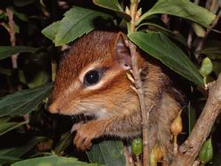
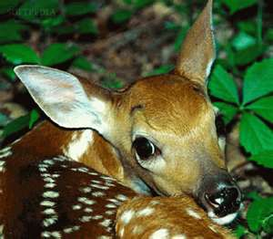
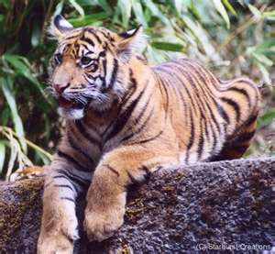
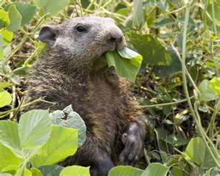
Mammals

Slide 2
Characteristics of Mammals
There are about 4000 kinds of mammals on the earth
Mammals are warm-blooded vertebrates that have hair and feed their young with milk produced in mammary glands
The word mammal comes from the term mammary gland
At one time during their lives, all mammals possess fur or hair

Slide 3
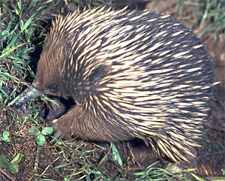
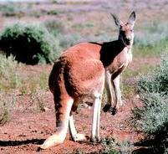
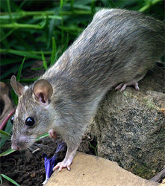
Believed to be the most intelligent animal on earth
Mammals are classified by the way their young develop
Egg-laying mammals
Pouched mammals
Placental mammals

Slide 4
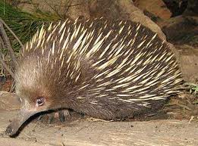
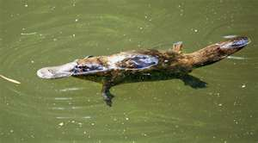
Egg-Laying Mammals
Mammals that lay eggs are called monotremes
Examples: spiny anteater, duckbilled platypus
The spiny anteater lays her eggs then places them in her pouch to develop

Slide 5
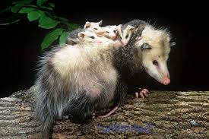
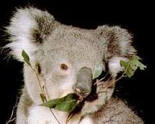
Pouched Mammals
Mammals with pouches are called marsupial
The young of marsupials are born only partially developed. They further develop in the pouch of their mother.
Example: kangaroos, koala, opossums

Slide 6
Placental Mammals
Placental Mammals develop totally inside the female
The females in this group of mammals have placenta
a structure through which the developing young receive food and oxygen while in the mother’s body. The placenta also removes wastes from the developing young.
There are more than 20 groups of placental mammals
They are grouped according to how they eat, move about, and where they live

Slide 7
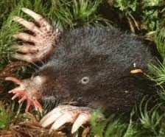
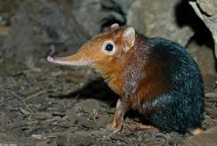
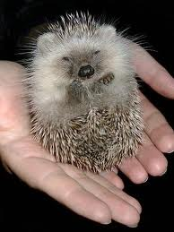
Insect-Eating Mammals
Example: star nosed mole
hedgehogs
shrew

Slide 8
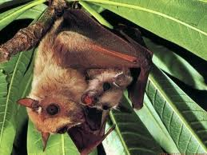
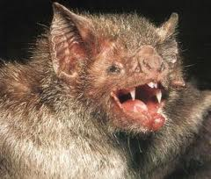
Flying Mammals
Bats are the only flying mammal 20% of all mammals in the world
2 types
Fruit eaters 30%
Insect eaters 70%

Slide 9
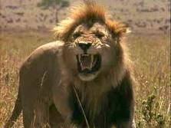
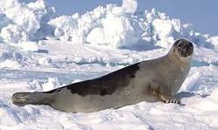
Flesh-Eating Mammals
All mammals in this group are carnivores, or flesh eaters
Carnivores are predators
Canines: pointed teeth next to the incisor
Incisors: one of the 4 front teeth used for biting
Examples: walruses, lions, and tigers, and bears OH MY

Slide 10
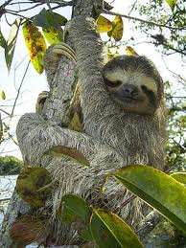
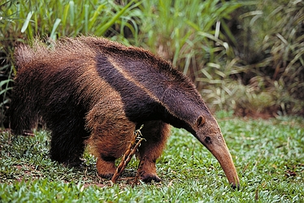
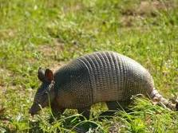
“Toothless Mammals”
True anteater belong to this group, however, they are the only mammal in this group without teeth
The other members, the armadillos and the sloths, have poorly developed teeth

Slide 11
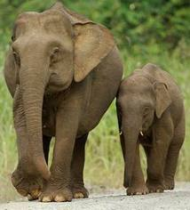
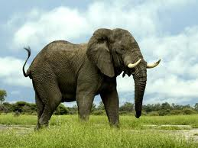
Trunk-Nosed Mammals
The elephant is the only mammal in this category
They have a distinguish trunk feature
They are the largest land animal
2 types
African
Asiatic
The ears of African elephants are larger than Asian elephants

Slide 12
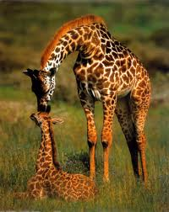
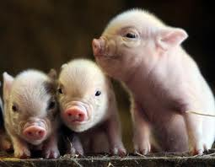
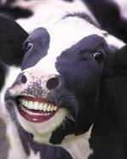
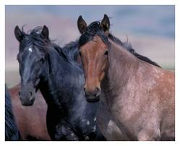
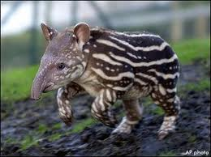
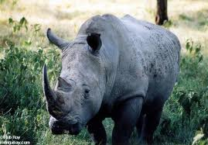
Hoofed Mammals
Divided into those with an even number of toes on each hoof, and those with an odd number
Even: pigs, camels, goats, cows, and giraffes
Odd: horses, rhino, tapirs

Slide 13
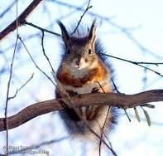
Gnawing Mammals
More of these mammals than any other on earth
Commonly known as rodents
Ex: squirrel, beavers, chipmunks, rat, mice, porcupines
Common characteristics are four special incisors that are used for gnawing
Rodents spread serious disease

Slide 14
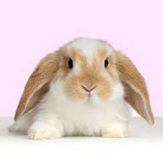
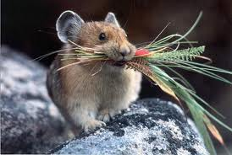
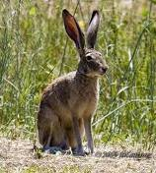
Rodentlike Mammals
Examples: rabbits, hares, pikas
Have gnawing teeth, similar to rodents
Unlike rodents, they have a small pair of grinding teeth behind their gnawing teeth

Slide 15
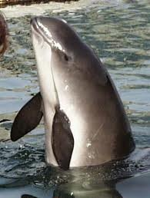
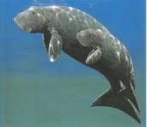
Water-Dwelling Mammals
Examples: whales, dolphins, porpoises, dugongs, and manatees
Intelligent
Have hair
Feed their young milk
Live in the water but breath air

Slide 16
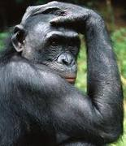
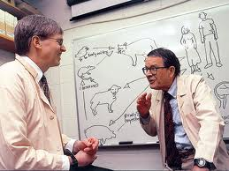
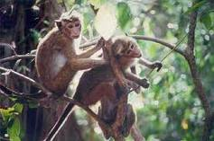
Primates
Have eyes that face forward
5 fingers on each hand
5 toes on each foot
Large brains most intelligent

