Slide 1
Microscopes
History, Parts,
& Functions

Slide 2
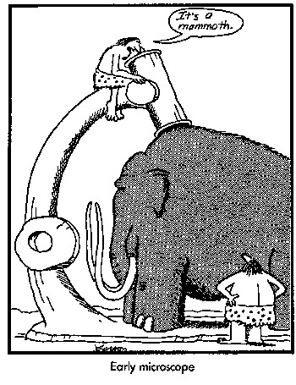
Early Microscope

Slide 3
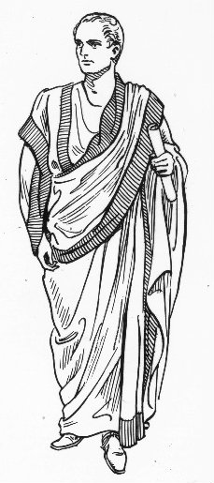
History of the Microscope
During the 1st century AD (year 100), glass had been invented and the Romans were looking through the glass and testing it.
  They experimented with different shapes of clear glass and one of their samples was thick in the middle and thin on the edges.
  They discovered that if you held one of these “lenses” over an object, the object would look larger.

Slide 4

History of the Microscope
These early lenses were called magnifiers or burning glasses.
The word lens by the way, is derived from the Latin word lentil, as they were named because they resembled the shape of a lentil bean

Slide 5
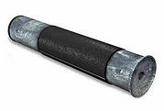
History of the Microscope
These magnifiers became popular in the 13th century when spectacle makers were producing lenses to be worn as glasses.
In 1590, two Dutch spectacle makers started experimenting with these lenses.
  Zaccharias Janssen and his father Hans
Experiments led by these men and other scientists led to the discovery of the compound microscope

Slide 6
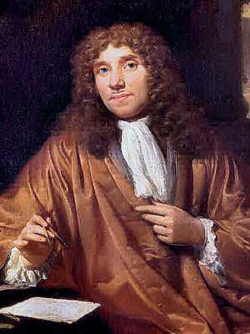
History of the Microscope
Many great people experimented with lenses, such as Galileo. But one man became the “father of microscopy” – his name is Anthony Leeuwenhoek (1632-1723)
  He saw bacteria, yeast, blood cells and many tiny animals swimming about in a drop of water.
  Compound microscopes had been invented in the 1590s, nearly forty years before Leeuwenhoek was born, however there were technical difficulties in building them.

Slide 7
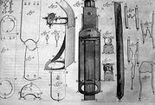
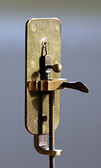
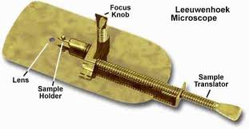

Slide 8
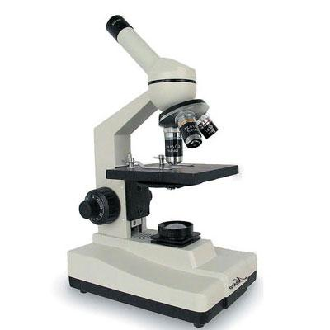
The Modern Compound Microscope
A compound light microscope is a microscope with more than one lens and its own light source.
  is an instrument commonly used inside the laboratory to view specimens mounted on a glass slide
  The compound microscope magnifies the object in the slide in such a way that the smallest structures become visible and clear.
  allowing structures in the slide to be magnified for up to 2,000 times their actual size.

Slide 9
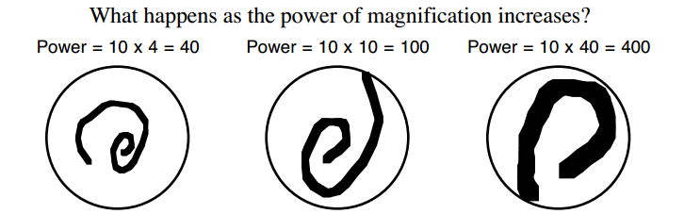
Magnification
If the magnification of a lens is 2X then it roughly doubles the size of the image of the object.

Slide 10
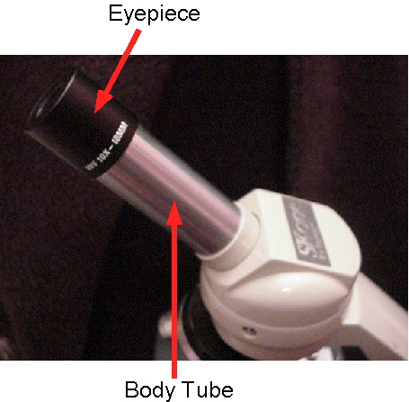
Parts of the Microscope
Eyepiece: the lens at the top that you look through.
Body Tube: Connects the eyepiece to the objective lenses

Slide 11
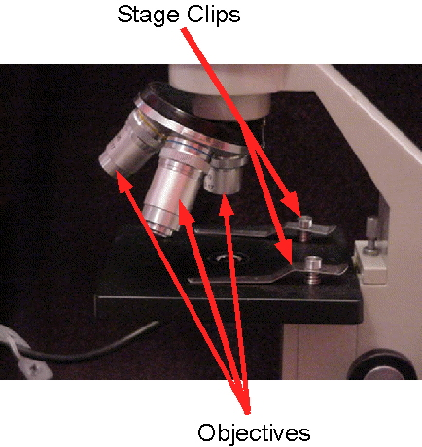
Parts of the Microscope
Stage Clips: clips that hold your slide in place
Objectives: Usually you will find 3 or 4 objective lenses on a microscope. They almost always consist of 4X, 10X, 40X and 100X powers.

Slide 12
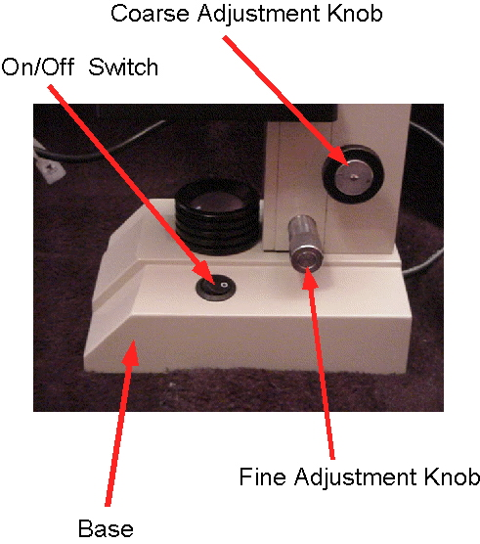
Parts of the Microscope
Coarse Adjustment Knob: Moves the stage up and down for FOCUSING
Fine Adjustment Knob: Moves the stage slightly to SHARPEN the image

Slide 14
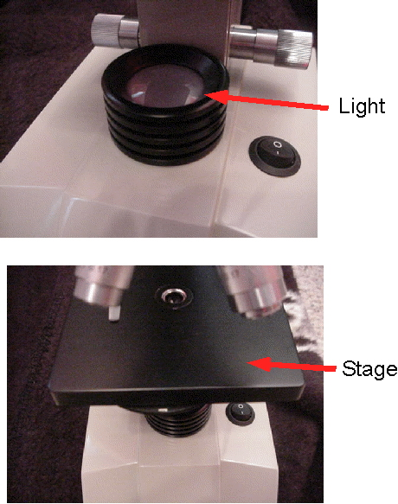
Parts of the Microscope
Light: A steady light source to help illuminate the slides
Stage: The flat platform where you place your slides.

Slide 15
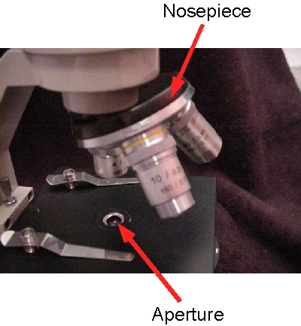
Parts of the Microscope
Nosepiece: This is the part that holds two or more objective lenses and can be rotated to easily change power.

Slide 16
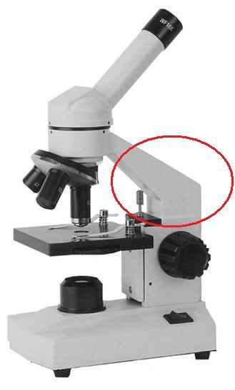
Parts of the Microscope
Arm
Arm: used to support the microscope when carried
Base: bottom of the microscope. Supports it.
Base

Slide 17
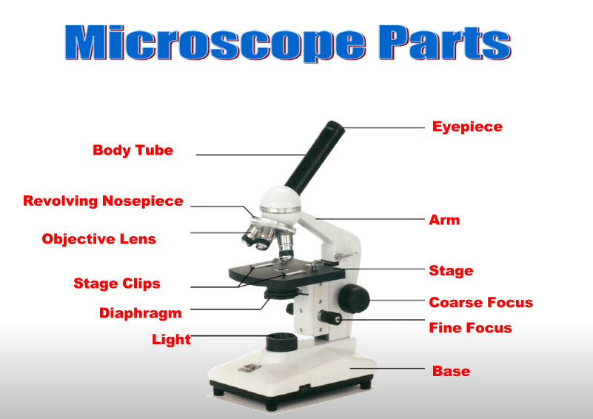

Slide 18
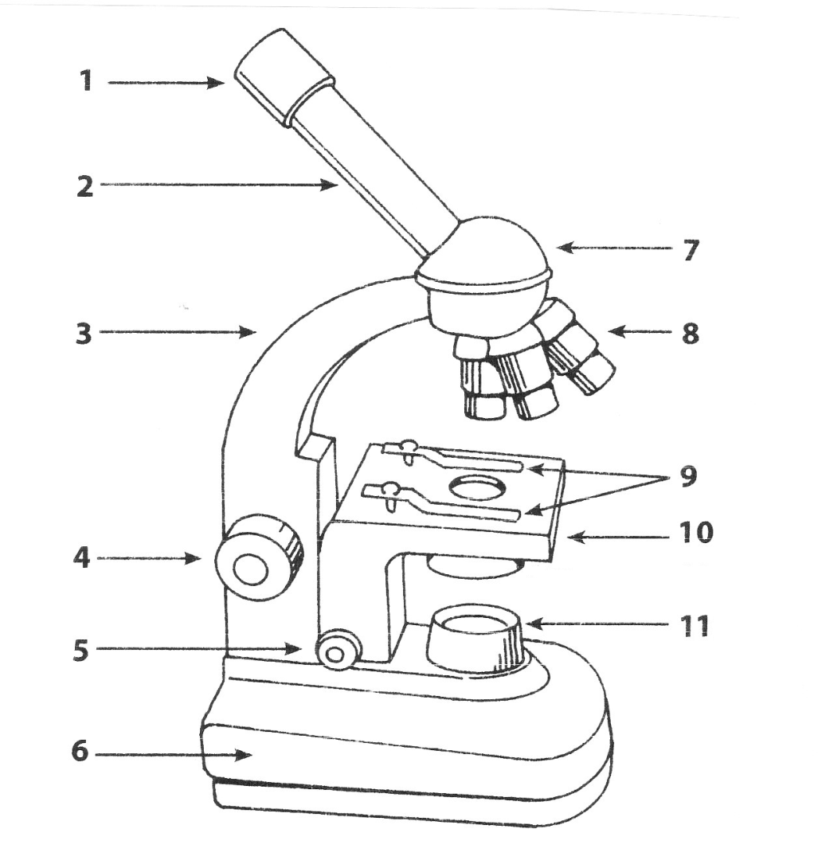

Slide 19
Let’s see the world of microscopes!

