Slide 2
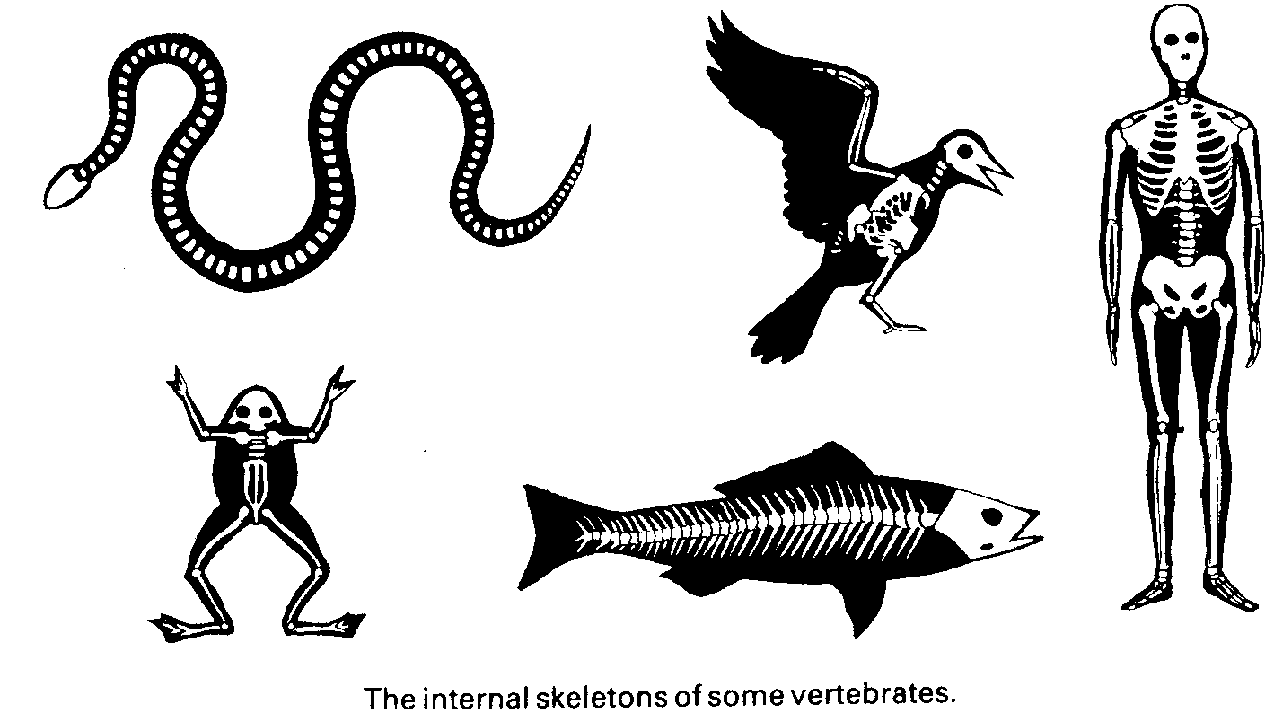
The main characteristic of all vertebrates is a backbone

Slide 3
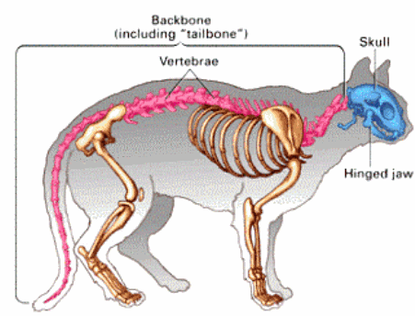
The bones that make up the backbone of a vertebrate are called vertebrae (singular: vertebra)
The skeleton provides support and helps give the body of a vertebrate its shape

Slide 4
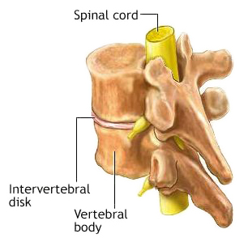
Vertebrate
One important advantage of an internal skeleton (endoskeleton) is that it increases in size as the animal grows
It does not need to shed, as does the exoskeleton of an insect
An important function of the backbone of a vertebrate is to protect the nerves of the spinal cord, which runs down through the center of the backbone
The spinal cord nerves connect the vertebrates well-developed brain to nerves that carry information to and from every part of the body

Slide 5
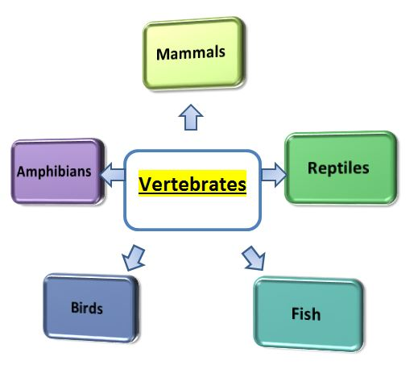
Types of Vertebrates
Fish
Amphibians
Reptiles
Birds
Mammals

Slide 6
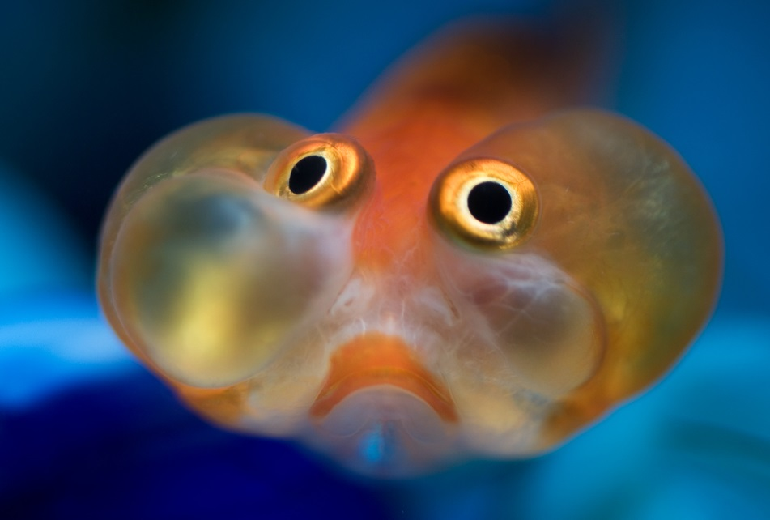
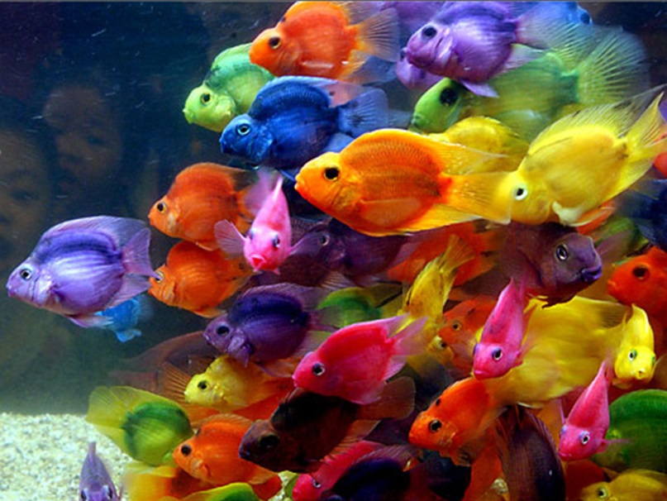
Fish
The first vertebrate with a backbone was a fish
Fish are the vertebrates that are best adapted to live under water
Smooth body
Fins
Gills
Etc

Slide 7
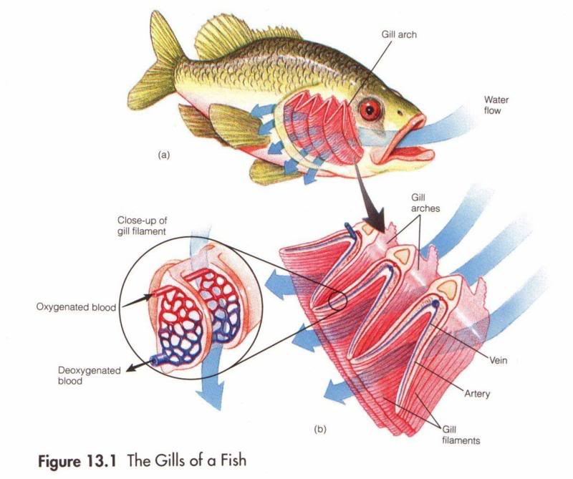
Like some vertebrates, fish take oxygen from the water through gills.

Slide 8
Fish
Fish live in all of the earth’s waters, in both fresh and salt water
Fish are coldblooded
They have no internal control over their body temperature.
Changes in environment affect their body temperature

Slide 9
Three Groups of Fish
Fish are divided into 3 groups
Jawless fish
Cartilaginous fish
Bony Fish

Slide 10
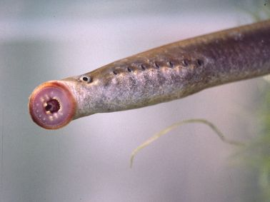
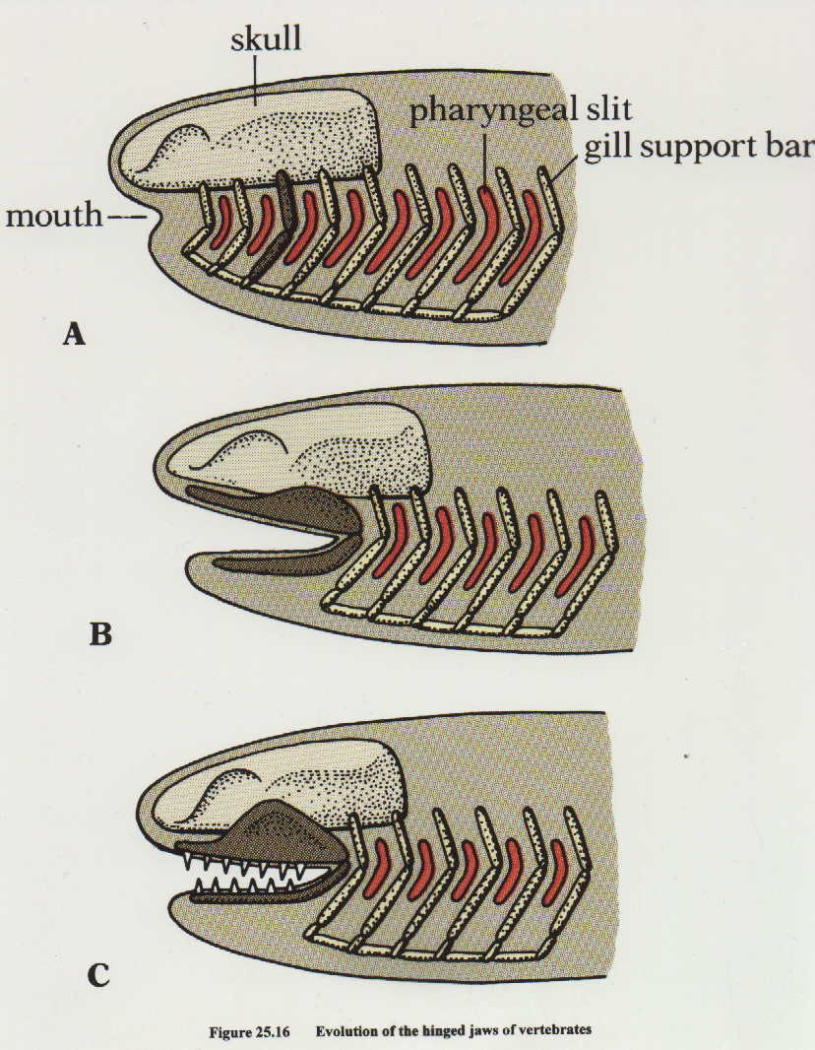
Jawless Fish
Jawless fish are the most primitive of all fish
They lack scales, fins, and jaws
Most common is the lamprey
They contain a flexible material called cartilage
The entire skeleton of a jawless fish is made of cartilage
They are very flexible

Slide 11
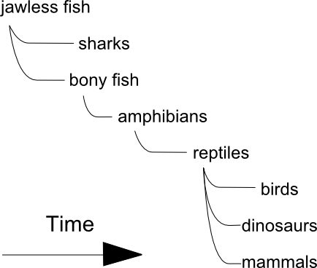
Time line: Development of Vertebrates

Slide 12
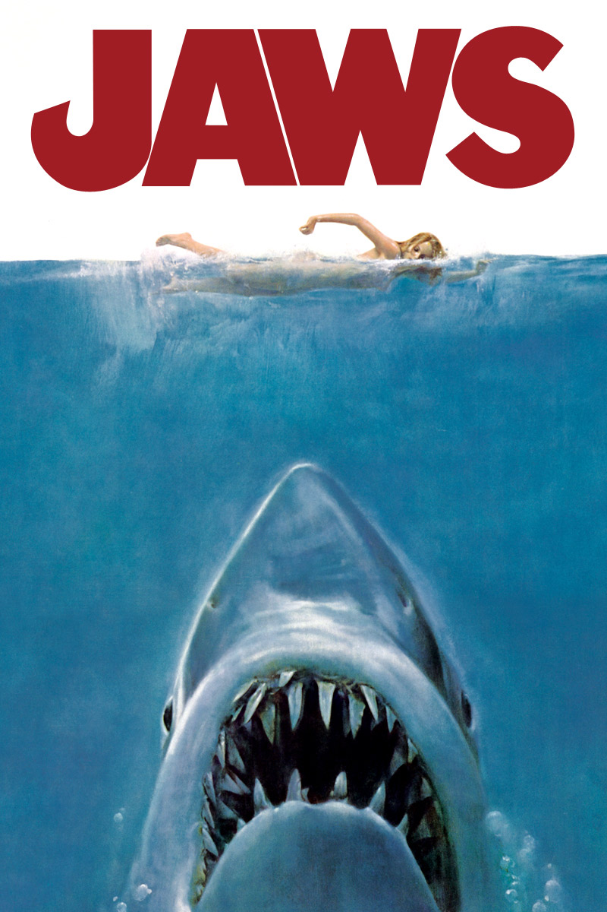
Cartilaginous Fish
Sharks are included in this group
Like jawless fish, their skeletons are made of cartilage.
This group has jaws

Slide 13
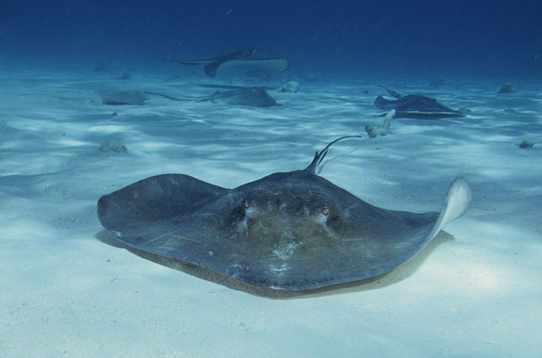
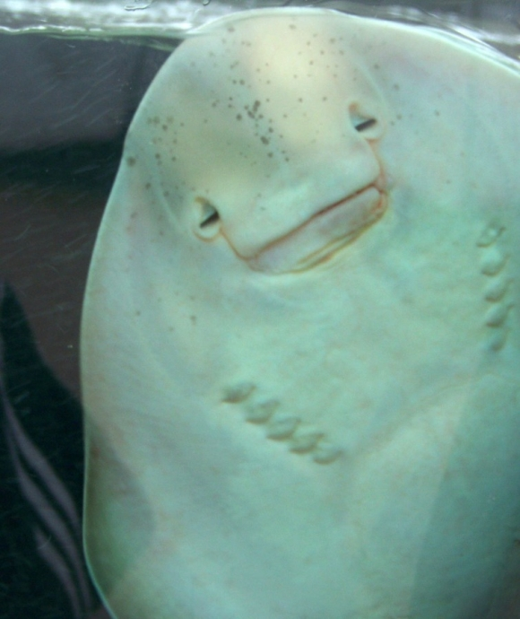
Cartilaginous Fish
Other cartilaginous fish include skates and rays

Slide 14
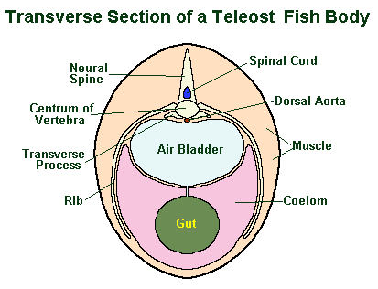
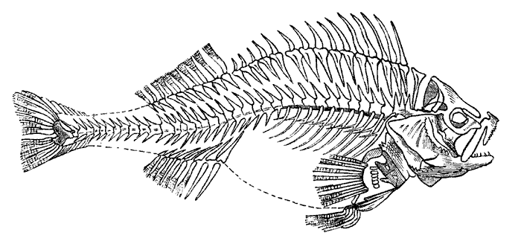
Bony Fish
Bony fish skeletons are composed of hard bones, many of which are quite small and sharp
Bony fish have a swim bladder
It is a sac that the fish can empty or fill with air
Acts like a life preserver
A fish can float at any level of water

Slide 15
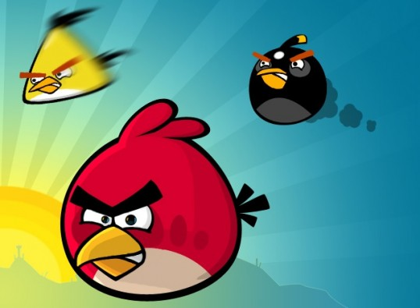
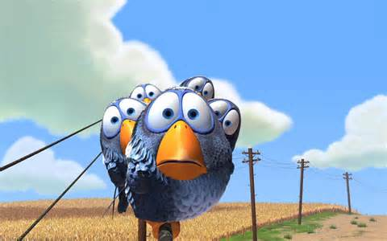
BIRDS

Slide 16
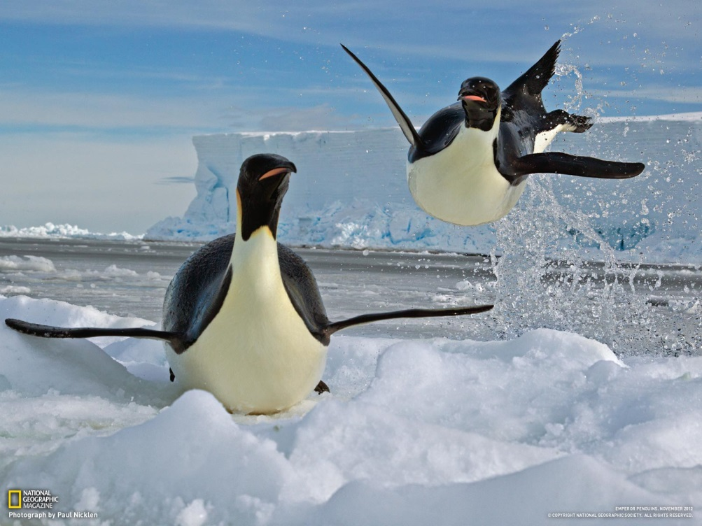
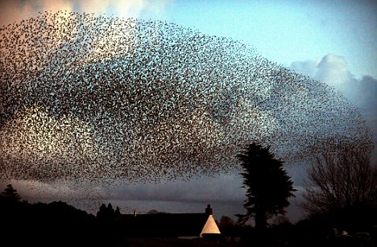
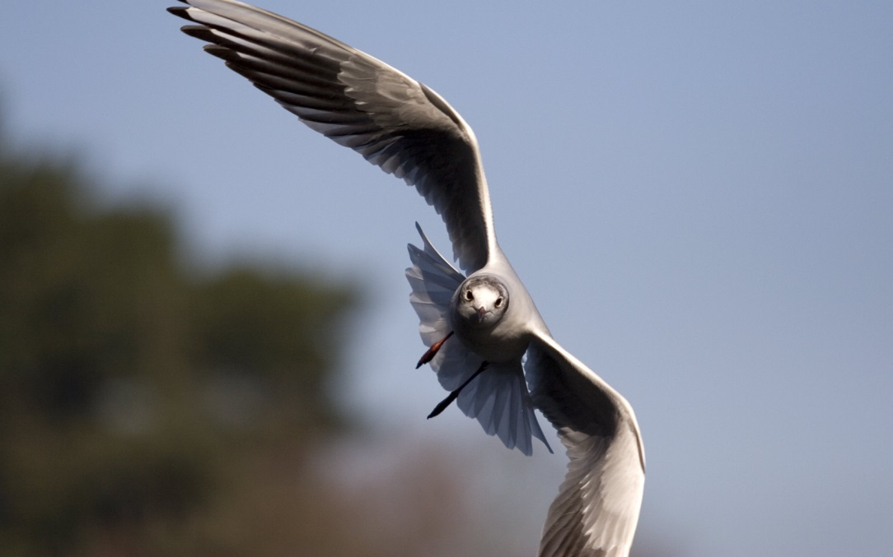
Birds
Birds are one of the species that have the ability of flight
However not all birds can fly

Slide 17
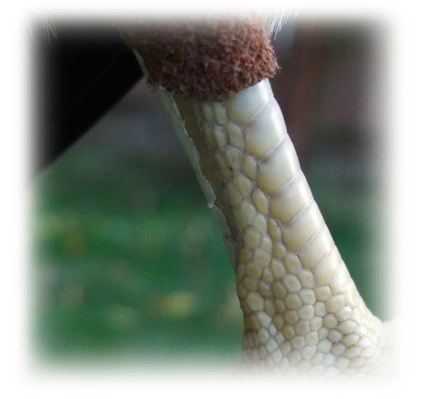
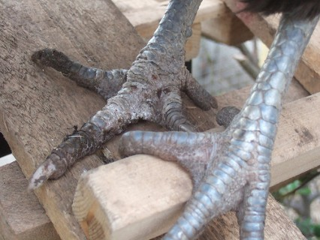
Birds
The earliest known bird lived more than 150 million years ago
They had characteristics of reptiles
Even birds today have scales on their legs

Slide 18
Birds
Birds are warm blooded vertebrates
They have the ability to maintain a constant body temperature despite the temperature of their environment.
They have wings
Their bodies are covered with feathers

Slide 19
Types of Birds
Birds can be divided into four main groups
Perching Birds
Their feet can easily grasp a branch
Examples: robins, cardinals, and sparrows
Water Birds
Their feet are adapted for swimming
Examples: Ducks and Geese
Birds of Prey
They are superb fliers, very fast, and also have keen eyesight
Example: Eagle
They have sharp claws called Talons. There enable the bird to grasp and hold it’s prey
Flightless Birds
Example: Penguins
They have strong muscles to enable them to run quickly

Slide 20
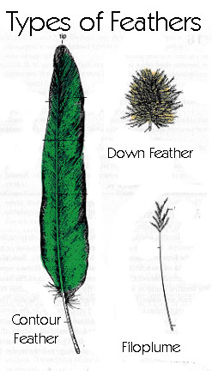
Adaptations of Flight
Birds have light, hollow bones – aids in flying
Birds are covered in feathers – aids in “lift”
The feathers of the wings and most the body feathers are called contour feathers
Other feathers, short and fuzzy are called down feathers.
Feathers aid in insulation

Slide 21
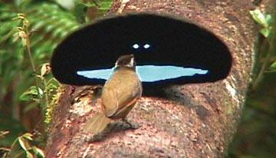
Breeding Habits & Development
Bird songs are used to establish territory
The bright feathers of male birds are used to attract females
Some birds attract a mate by constructing a large and colorful nest
Most birds build nest
A bird’s egg is encased within a hard, strong shell
Most birds incubate their eggs by sitting on them

Slide 22
Migration
Many birds Migrate, or move to a new environment, during the course of a year
Birds migrate for many reasons, the most important reason is to follow seasonal food supplies
Some birds are believed to have magnetic centers in their brain
These centers act like a compass to help their bird find its way

Slide 23
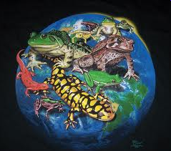
Amphibians
The word amphibian means double life
Amphibians spend part of their lives in water and part on land
Amphibians breath through their skin so it must remain damp in order to take in oxygen

Slide 24
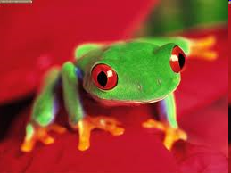
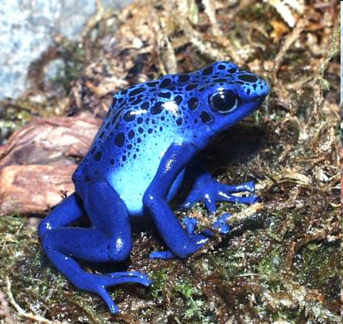
Frogs and Toads
In the winter frogs and toad dig into the mud and hibernate
During hibernation all body activities slow down so that the animal can live on food stored in its body
Unlike tadpoles, adult frogs and toad are carnivorous
Male frogs and toads use their sounds to attract mates
Frogs and toad appear similar, but frogs have a smooth moist skin and toads are drier and have wart like bumps
In many toad the bumps right behind the eyes contain a poisonous liquid

Slide 25
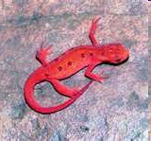
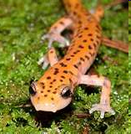
Salamanders and Newts
Both are amphibians with tails
Live in moist areas
Must lay their eggs in water just like frogs and toads

Slide 26
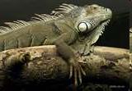
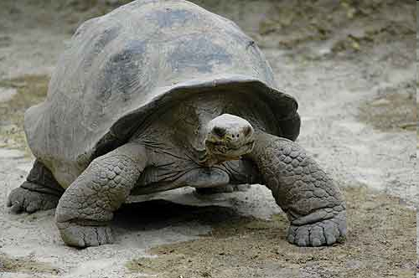
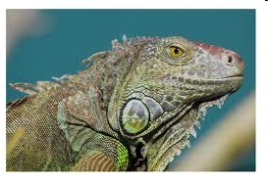
Reptiles
Reptiles are coldblooded vertebrates that have dry, scaly skin and lay eggs on land
Do not have to go through a water dwelling stage in their lives
Eggs have a lathery protective covering to keep it from drying out
Since the eggs are enclosed in a shell, the females body fertilizes the egg before the shell forms

Slide 27
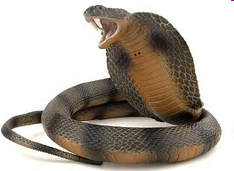
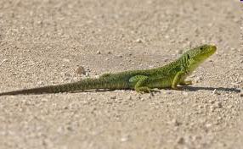
Snakes and Lizards
Snakes that are poisonous have developed special glands that produce their venom
Snakes have developed numerous way to find their prey
Detect body heat with the pits on the sides of their head
Tasting the air with their tongue for prey
Snakes are deaf and have poor eye sight
A snake moves by wriggling its muscular body
Lizards differ from snakes because they…
Have legs
Have ears
Can detect sound

Slide 28
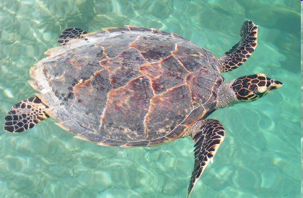
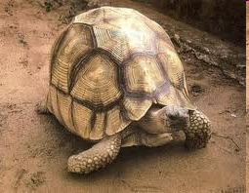
Turtles and Tortoises
Both are reptiles that look alike but have adapted to different environments
Turtles spend most of their time in water, their legs are shaped like paddles
Tortoises spend most time on land. They have solid, stumpy legs used for walking.
Both can live for a long time

Slide 29
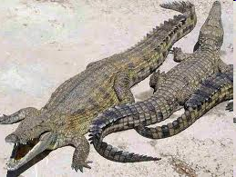
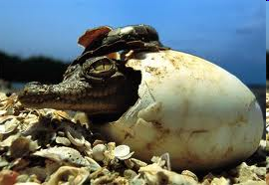
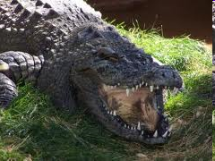
Alligators and Crocodiles
Both spend most of their time submerges in water with only their eyes and nostrils above the surface
Both eat meat
Both have unusual reproductive behaviors
Unlike most reptiles they care for their young after they hatch

